Slide 1
CONTRAST ENHANCEMENT OF IMAGES WITH DIRECTIONAL FEATURES
Project Mentor:
Dr. S. Mukhopdhay,
Associate Professor
By:
Siram Reddy Sai Praveen
2009JE0623

Slide 2
Flow of presentation
Aim
Proposed Method – Contrast Enhancement of directional features using Directional Morphology
Traditional Method – Gabor Filter based technique
Output of both methods on some input images
Comparision of both methods using some metrics
Conclusion
References

Slide 3
1.Aim
Feature matching in images has been a very important step in many applications like fingerprint recognition, landscape analysis etc.
Contrast of such features in the input images has to be rich enough to reliably use them as input
The aim of this project is to enhance the Directional Features of the grayscale images

Slide 4
2.Proposed Method (Using Directional Morphology)
Structuring element construction
Directional Opening
Directional Closing
Top Hat Transformation
Bottom Hat Transformation
Contrast Enhancement

Slide 5
Structuring Element Construction
There are 16 different structuring elements, each a line, with a different slope from +90° to -90°
The slopes are taken approximately at a difference of 11.25°
+90° (1,0) 0° (0,1)
+78.75° (1,5) -78.75° (1,-5)
+67.50° (2,5) - 67.50° (2,-5)
+56.25° (2,3) - 56.25° (2,-3)
+45° (1,1) -45° (1,-1)
+33.75° (3,2) -33.75° (3,-2)
+22.50° (5,2) - 22.50° (5,-2)
+11.25° (5,1) - 11.25° (5,-1)

Slide 6
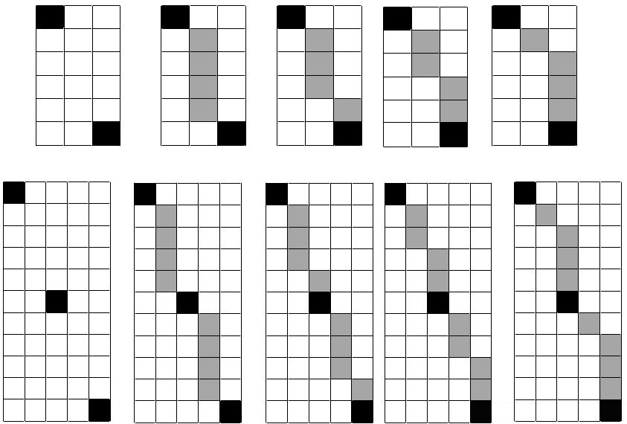
Structuring element with slope (2,-5) (approximately 67.5°)

Slide 7
Dilation:
Erosion:
Directional Opening:
Directional Closing:

Slide 8
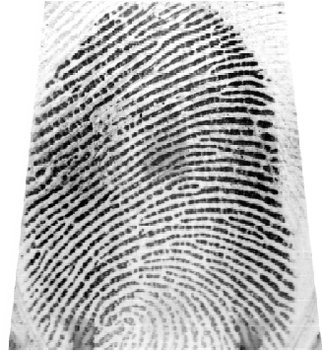
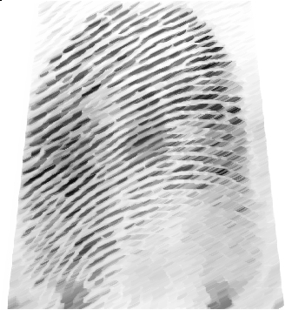
Original image :: Closed image (2,1)2

Slide 9
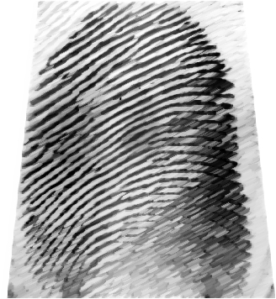
Original image::Opened image(2,1)2

Slide 10


Top Hat Transformation
Top hat transformation extracts the white features of the image
Top Hat Transform, (x,y) = Original Image -
T(x,y)=
Bottom Hat Transformation
Bottom hat transform extracts the dark features of the image
Bottom Hat Transform, (x,y) = - Original Image
B(x,y)=

Slide 11
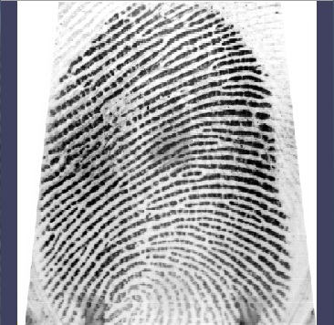
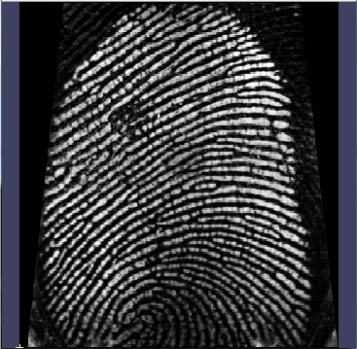
Original image:: Bottom Hat

Slide 12
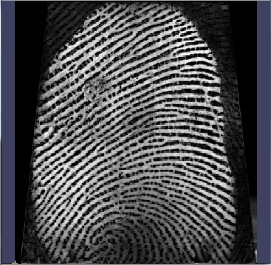
Original image::Top Hat

Slide 13
Contrast Enhancement

Slide 14
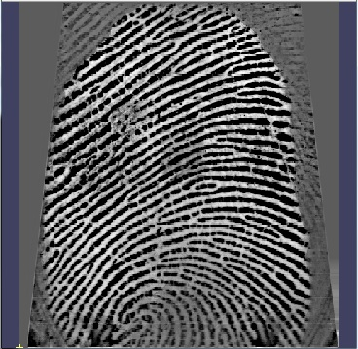
Original image:: Output image

Slide 15
Traditional method-Gabor Filter based technique
The 2-D Gabor function is a harmonic oscillator, composed of a sinusoidal plane wave of a particular frequency and orientation, within a Gaussian envelope.
Where

Slide 16
Here λ= wavelength of the sinusoidal wave
Ѳ= orientation of the line (arctan(x/y))
γ = factor supporting the ellipticity of the curve
φ= phase offset
Here we vary the Ѳ in 16 different orientations and generate the filters corresponding, using the (x,y) grid of size (m,n) [In our code (m,n)=(5,5)]
λ=2
γ=0.2
φ=0
σ=1
(m,n)=(5,5)
-2,2 | -1,2 | 0,2 | 1,2 | 2,2
-2,1 | -1,1 | 0,1 | 1,1 | 2,1
-2,0 | -1,0 | 0,0 | 1,0 | 2,0
-2,-1 | -1,-1 | 0,-1 | 1,-1 | 2,-1
-2,-2 | -1,-2 | 0,-2 | 1,-2 | 2,-2

Slide 17
0 | +/-90
78.75 | -78.75
67.5 | -67.5
56.25 | -56.25
45 | -45
33.75 | -33.75
22.5 | -22.5
11.25 | -11.25
Gabor Filter for Ѳ=45°
0.001376 | 0.007884 | 0.026805 | 0.054100 | 0.064819
0.007884 | 0.027899 | 0.058606 | 0.073083 | 0.054100
0.026805 | 0.058606 | 0.076065 | 0.058606 | 0.026805
0.054100 | 0.073083 | 0.058606 | 0.027899 | 0.007884
0.064819 | 0.054100 | 0.026805 | 0.007884 | 0.001376

Slide 18
Then the contrasted image is obtained by performing the following operation
C(X,Y) = F(x,y) + λ[F(x,y) - ]
Where =
where is the output for orientation,

Slide 19
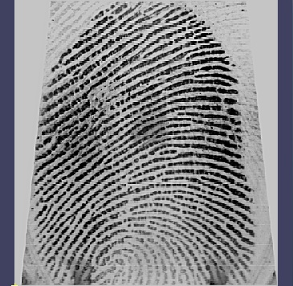
Original image
Output of Gabor Filter based technique

Slide 20
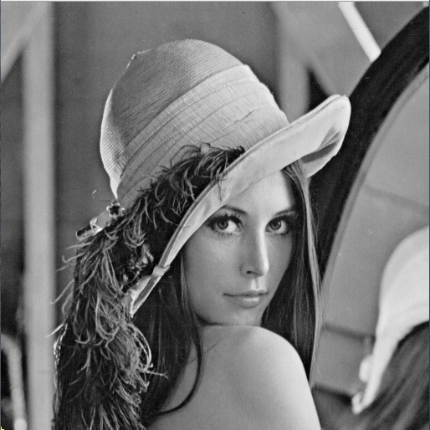
Consider the following images for the above mentioned two methods

Slide 21
On fingerprint
Gabor Filter based technique
Using Directional Morphology

Slide 22

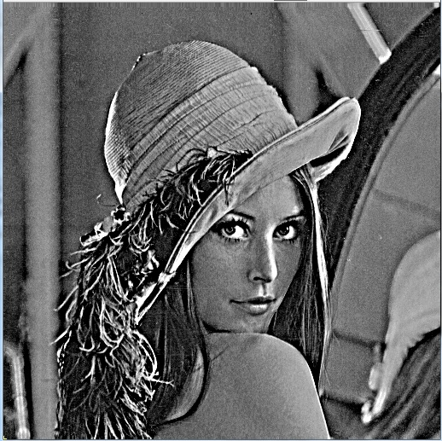
On Lena image
Gabor Filter based technique
Using Directional Morphology

Slide 23
Metrics
1. Measure of Enhancement(EME):
Here, image I is divided into k1*k2 number of blocks each of size m*n.
Imax;m,n and Imin;m,n are the maximum and minimum
intensity values respectively in each block. The high value of
EME indicates the contrast is high.

Slide 24
2. Contrast Improvement Ratio(CIR): It computes the squared error between the contrast before and after enhancement. It is defined as
c and c~ represent the local contrast before and after enhancement respectively. The term c(x,y) is calculated by taking the difference of the mean values in two rectangular windows centered on the pixel (x,y) as:
C(x,y)=[μ0- μn]/[| μ0 + μn |]
Here, μ0 is the central mean value of a 3 X 3 region and μn is the mean gray level value of the pixels in a 7 X 7 neighborhood region surrounding the 3 X 3 window.

Slide 25
Measurements for both enhancements
Fingerprint | Using Gabor Technique | Using Directional Morphology
EME (5x5) | 72.569580 | 121.426933
CIR | 0.050051(5%) | 0.244657(24%)
Lena | Using Gabor Technique | Using Directional Morphology
EME (5x5) | 15.962998 | 52.132599
CIR | 0.002229 (.22%) | 0.070037 (7%)

Slide 26
Conclusion
From the observation of the output of both methods and tabulated metrics, it shown that the Contrast of the Directional Features is better enhanced in the method that uses Directional Morphology than in the method that uses Gabor Filter.

Slide 27
References
1. “Digital Image Processing” by Gonzalez,woods 2nd Edition
2. http://en.wikipedia.org/wiki/Gabor_filter
3.”Computer Graphics” by Hearn and Baker
4.”Periodic lines: Definitions, cascades and application to granulometries ”, by Ronald Jones and Pierre Solle – Pattern Recognition Letters
5. J. Serra, “Image analysis using mathematical morphology”, Academic Press, London, 1982.
6. S. Sternberg, “Grayscale morphology”, Computer Graphics and Image Processing, vol. 35, pp. 333-355, 1986.
7.P. Soille, “Morphological operators with discrete line segments”, Proc. Discrete Geometry for Computer Imagery 2000, G. Borgefors, I. Nystrom, and G. Sanniti di Baja, eds., pp. 78-98, 2000.

Slide 28
8. P. Soille, E. Breen, and R. Jones, “Recursive implementation of erosions and dilations along discrete lines at arbitrary angles”, IEEE Trans. Pattern Analysis and Machine Intelligence, vol. 18, no. 5, pp. 562-567, May 1996.
9. S. Sternberg, “Grayscale morphology”, Computer Graphics and Image Processing, vol. 35, pp. 333-355, 1986.
10. P. Soille, “Morphological image analysis”, Berlin, Heidelberg, New York: Springer- Verlag, 1999.

